Slide 1
Clustering
By : Babu Ram Dawadi

Slide 2
Clustering
cluster is a collection of data objects, in which the objects similar to one another within the same cluster and dissimilar to the objects in other clusters
Cluster analysis is the process of finding similarities between data according to the characteristics found in the data and grouping similar data objects into clusters.
Clustering: Given a database D = {t1, t2, .., tn}, a distance measure dis(ti, tj) defined between any two objects ti and tj, and an integer value k, the clustering problem is to define a mapping f: D -> {1, …, k} where each ti is assigned to one cluster Kj, 1<=j<=k. here ‘k’ is the number of clusters.

Slide 3
Examples of Clustering Applications
Marketing: Help marketers discover distinct groups in their customer bases, and then use this knowledge to develop targeted marketing programs
Land use: Identification of areas of similar land use in an earth observation database
Insurance: Identifying groups of motor insurance policy holders with a high average claim cost
City-planning: Identifying groups of houses according to their house type, value, and geographical location
Earth-quake studies: Observed earth quake epicenters should be clustered along continent faults

Slide 4
Categories of Clustering
main categories (classes) of clustering methods
Partition-based
Hierarchical
Density-based
Grid-based
Model-based

Slide 5
Partitioning Algorithms: Basic Concept
Partitioning method: Construct a partition of a database D of n objects into a set of k clusters
Given a k, find a partition of k clusters that optimizes the chosen partitioning criterion
  Heuristic methods: k-means and k-medoids algorithms
  k-means (MacQueen’67): Each cluster is represented by the center of the cluster
  k-medoids or PAM (Partition around medoids): Each cluster is represented by one of the objects in the cluster

Slide 6
The K-Means Clustering Method
Chose k number of clusters to be determined
Chose k objects randomly as the initial cluster centers
Repeat
  Assign each object to their closest cluster center, using Euclidean distance
  Compute new cluster centers, calculate mean point
Until
  No change in cluster centers or
  No object change its clusters

Slide 7
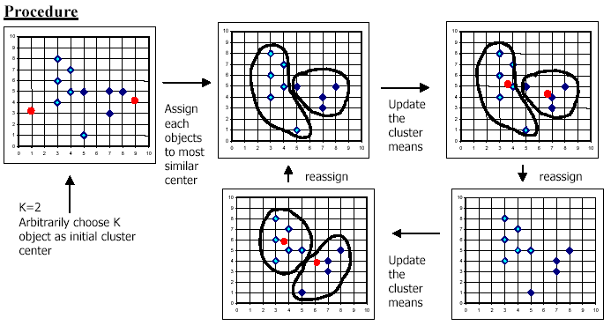
The K-Means Clustering Method

Slide 8
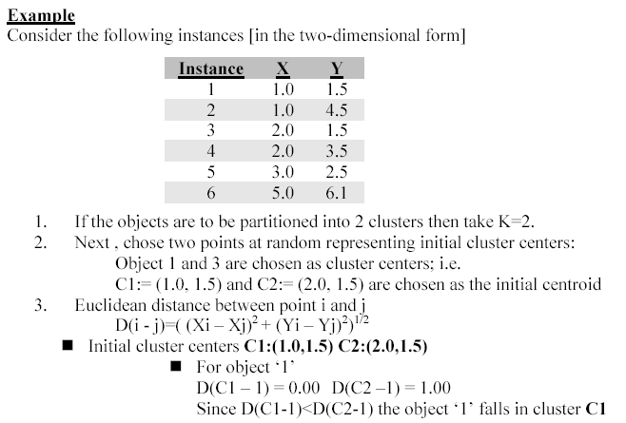
K-Means Clustering

Slide 9
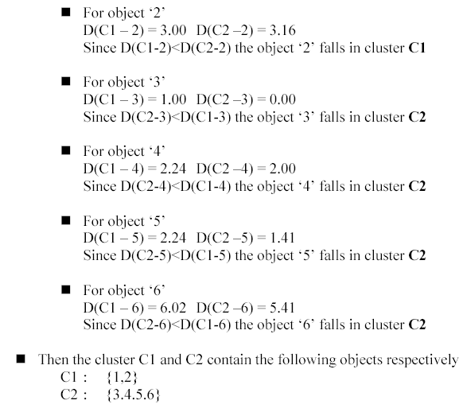
K-Means Clustering

Slide 10
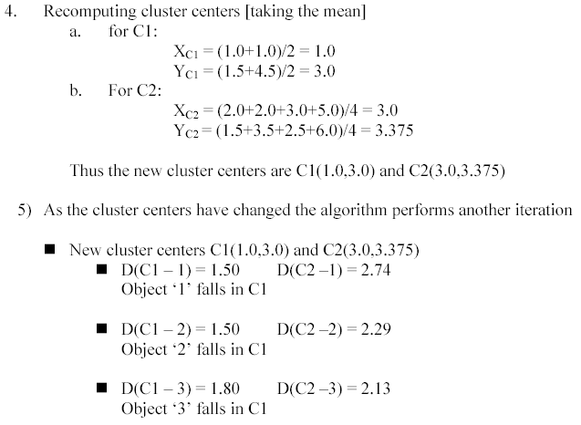
K-Means Clustering

Slide 11
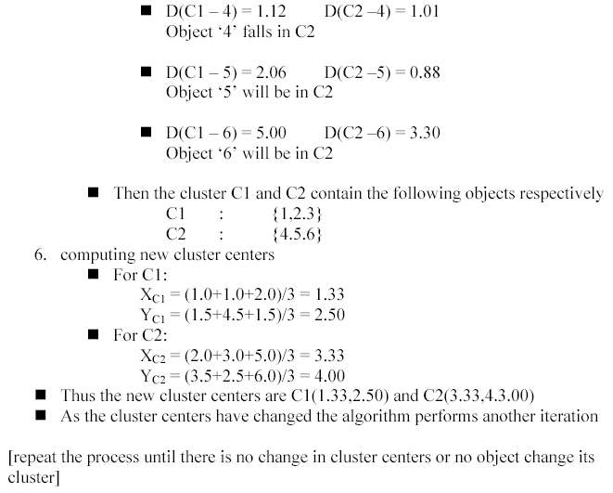
K-Means Clustering

Slide 12
Weakness of K-means
Applicable only when mean is defined, then what about categorical data?
Need to specify K, the number of clusters, in advance
  run the algorithm with different K values
Unable to handle noisy data and outliers
Works best when clusters are of approximately of equal size

Slide 13
Hierarchical Clustering
Clustering comes in a form of a tree – dendrogram visualizing how data contribute to individual clusters
Clustering is realized in a successive manner through:
successive splits, or
successive aggregations

Slide 14
Hierarchical Clustering
Provides graphical illustration of relationships between the data in the form of dendrogram
Dendrogram is a binary tree
Two fundamental approaches:
  Bottom – up (agglomerative approach)
  Top-down (divisive approach)

Slide 15
Hierarchical Clustering: Types
Agglomerative(Bottom-up or agglomerative):
  starts with as many clusters as there are records, with each cluster having only one record. Then pairs of clusters are successively merged until the number of clusters reduces to k.
  at each stage, the pair of clusters are merged which are nearest to each other. If the merging is continued, it terminates in the hierarchy of clusters which is built with just a single cluster containing all the records.
Divisive algorithm (Top-down or divisive ): takes the opposite approach from the agglomerative techniques. These starts with all the records in one cluster, and then try to split that clusters into smaller pieces.

Slide 16
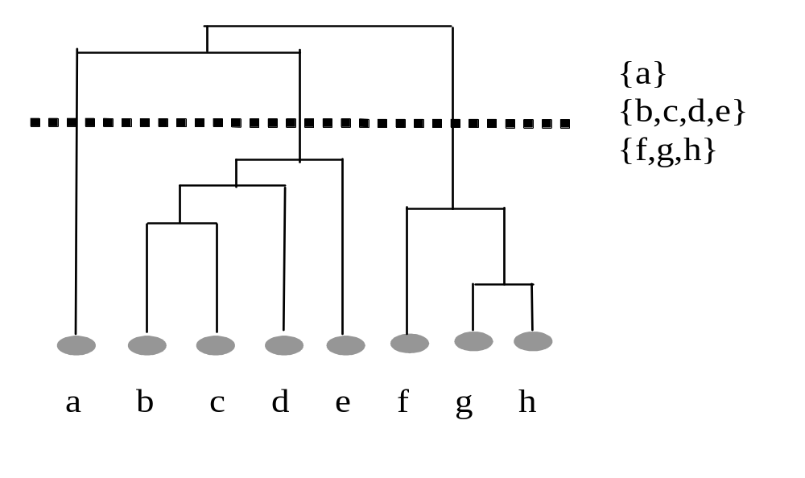
Hierarchical Clustering
Top -down
Bottom-up

Slide 17
Hierarchical methods
Agglomerative methods start with each object in the data forming its own cluster, and then successively merge the clusters until one large cluster is formed (that encompasses the entire dataset)
Divisive methods start by considering the entire data as one cluster and then split up the cluster(s) until each object forms one cluster

Slide 18
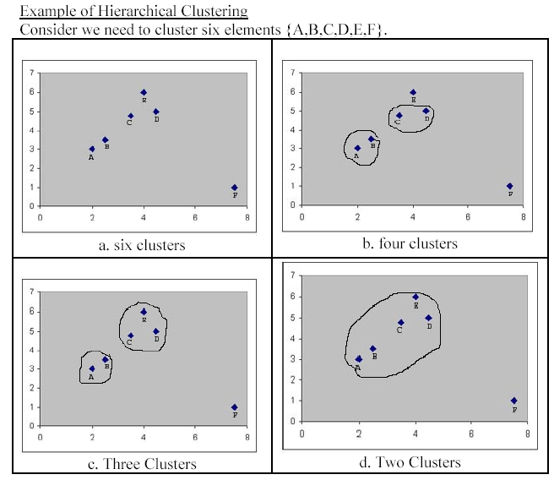
Divisive
Remove
Outlier
Agglomerative

Slide 19
Density-Based Clustering Methods (DENCLUE)
Clustering based on density (local cluster criterion), such as density-connected points
Major features:
  Discover clusters of arbitrary shape
  Handle noise
  One scan
  Need density parameters as termination condition
Several interesting studies:
  DBSCAN: Density Based Spatial Clustering of Application Noise
  OPTICS: Ordering Points to Identify the Clustering Structures
  CLIQUE : Clustering in Clique

Slide 20
Density-Based Clustering: Background
The basic terms
  The neighbourhood of an object that enclosed in a circle with radius Eps is called Eps - neighbourhood of that object
  Eps neighbourhood with minimum object points is called core object.
  An object A from a dataset is directly density reachable from object B where A is the member of Eps- neighbourhood of B and B is a core object.

Slide 21
Density-Based Clustering:
Density-reachable:
  A point p is density-reachable from a point q wrt. Eps, MinPts if there is a chain of points p₁, …, p_{n}, p₁ = q, p_{n} = p such that p_{i+1} is directly density-reachable from p_{i}
Density-connected
  A point p is density-connected to a point q wrt. Eps, MinPts if there is a point o such that both, p and q are density-reachable from o wrt. Eps and MinPts.
p
p₁
q
p
q
o

Slide 22
DBSCAN: Density Based Spatial Clustering of Applications with Noise
Relies on a density-based notion of cluster: A cluster is defined as a maximal set of density-connected points
Discovers clusters of arbitrary shape in spatial databases with noise
Outlier
Border
Eps = 1cm
MinPts = 5
Core

Slide 23
DBSCAN: The Algorithm
  Arbitrarilyy select a point p
  Retrieve all points density-reachable from p wrt Eps and MinPts.
  If p is a core point, a cluster is formed.
  If p is a border point, no points are density-reachable from p and DBSCAN visits the next point of the database.
  Continue the process until all of the points have been processed.

Slide 24
Grid-Based Clustering Method
Using multi-resolution grid data structure
Several interesting methods
  STING (a STatistical INformation Grid approach) by Wang, Yang and Muntz (1997)
  WaveCluster by Sheikholeslami, Chatterjee, and Zhang (VLDB’98)
    A multi-resolution clustering approach using wavelet method
  CLIQUE: Agrawal, et al. (SIGMOD’98)

Slide 25
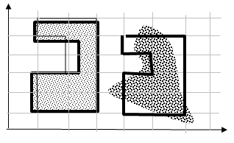
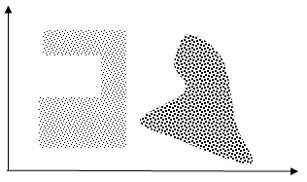
Grid-Based Clustering
Describe structure in data in the language of generic
geometric constructs – hyperboxes and their combinations
Formation of clusters by merging adjacent hyperboxes of the grid
Collection of clusters of different geometry
© 2007 Cios / Pedrycz / Swiniarski / Kurgan

Slide 26
Grid-Based Clustering Steps
Formation of the grid structure
Insertion of data into the grid structure
Computation of the density index of each hyperbox of the grid structure
Sorting the hyperboxes with respect to the values of their density index
Identification of cluster centers (viz. the hyperboxes of the highest density)
Traversal of neighboring hyperboxes and merging process
Choice of the grid:
  too rough grid may not help capture the details of the structure in the data.
  too detailed grid produces a significant computational overhead.

Slide 27
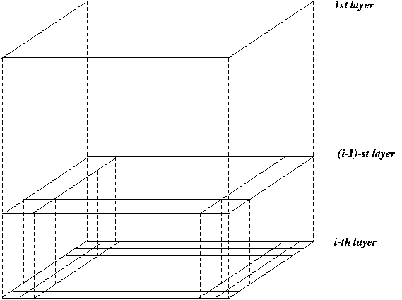
STING: A Statistical Information Grid
The spatial area is divided into rectangular cells
There are several levels of cells corresponding to different levels of resolution

Slide 28
STING: A Statistical Information Grid
  Each cell at a high level is partitioned into a number of smaller cells in the next lower level
  Statistical info of each cell is calculated and stored beforehand and is used to answer queries
  Parameters of higher level cells can be easily calculated from parameters of lower level cell
    count, mean, s, min, max
    type of distribution—normal, uniform, etc.
  For each cell in the current level compute the confidence interval

Slide 29
STING: A Statistical Information Grid
  Remove the irrelevant cells from further consideration
  When finish examining the current layer, proceed to the next lower level
  Repeat this process until the bottom layer is reached
  Advantages:
    Query-independent, easy to parallelize, incremental update
    O(K), where K is the number of grid cells at the lowest level
  Disadvantages:
    All the cluster boundaries are either horizontal or vertical, and no diagonal boundary is detected

Slide 30
Model-Based Clustering Methods
Attempt to optimize the fit between the data and some mathematical model
Statistical and AI approach
  COBWEB (Fisher’87)
    A popular a simple method of incremental conceptual learning
    Creates a hierarchical clustering in the form of a classification tree
    Each node refers to a concept and contains a probabilistic description of that concept

Slide 31

COBWEB Clustering Method
A classification tree

Slide 32
Summary
Cluster analysis groups objects based on their similarity and has wide applications
Clustering algorithms can be categorized into partitioning methods, hierarchical methods, density-based methods, grid-based methods, and model-based methods
Outlier detection and analysis are very useful for fraud detection, etc. and can be performed by statistical, distance-based or deviation-based approaches

